Slide 1

Earthquake Project Analysis
Presented By:-Ankit Rajak
Project File:-Earthquake Project Analysis

Slide 2

Introduction:-
An earthquake is a sudden and powerful shaking of the Earth's surface caused by the movement of tectonic plates beneath the crust. These movements occur due to the release of accumulated energy along fault lines, resulting in seismic waves that can cause significant damage to infrastructure, the environment, and human life. Earthquakes vary in magnitude and can trigger secondary disasters such as tsunamis, landslides, and aftershocks.
Earthquakes are natural phenomena that affect various regions worldwide, particularly those located along active fault lines. Understanding their causes, predicting their occurrence, and preparing for their effects are crucial for minimizing their impact. With advancements in technology, scientists use seismographs and other tools to monitor seismic activity and study earthquake patterns, contributing to better disaster preparedness and response efforts.
Preparedness and resilient infrastructure are key to reducing the devastating effects of earthquakes on vulnerable populations and regions.

Slide 3

Objective:-
The earthquake project analysis aims to explore and understand seismic activity patterns, focusing on the frequency, magnitude, and geographical distribution of earthquakes. Earthquakes, as natural disasters, pose significant risks to human life, infrastructure, and the environment, making it crucial to study their behavior for better preparedness and mitigation strategies. This project focuses on analyzing historical earthquake data, examining factors like fault lines, tectonic movements, and aftershock patterns, to provide insights into regions most vulnerable to seismic activity.
By analyzing key metrics such as earthquake magnitude, depth, and epicenter locations, this project seeks to identify trends and patterns that can help predict the likelihood of future seismic events. The analysis also evaluates the impact of earthquakes on various regions, highlighting the importance of building resilient infrastructure and disaster management strategies.
The ultimate goal of this project is to contribute to the understanding of earthquake dynamics, aiding governments, scientists, and urban planners in developing effective strategies to reduce the impact of earthquakes and protect vulnerable communities.

Slide 4
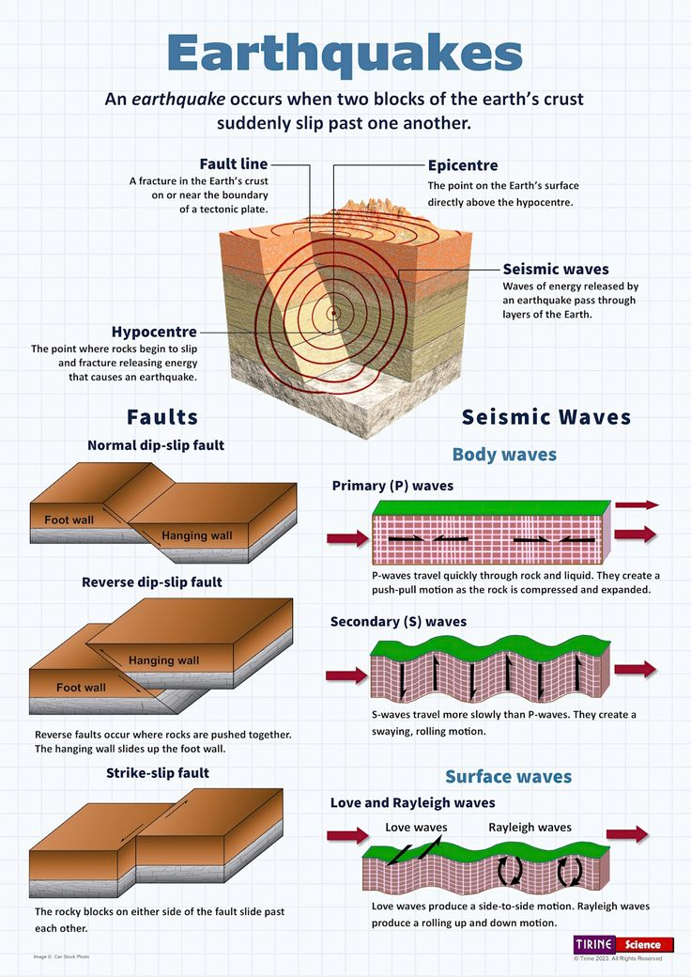
Key Challenges:-
1.Count of Years with Highest Richter Values.
2.Count of Richter Scale Values by Area and Region.
3.Count of Richter Scale Values by Region.
4.Number of Deaths per Year for Different Richter Scale Values.
5.Total Deaths by Region.

Slide 5
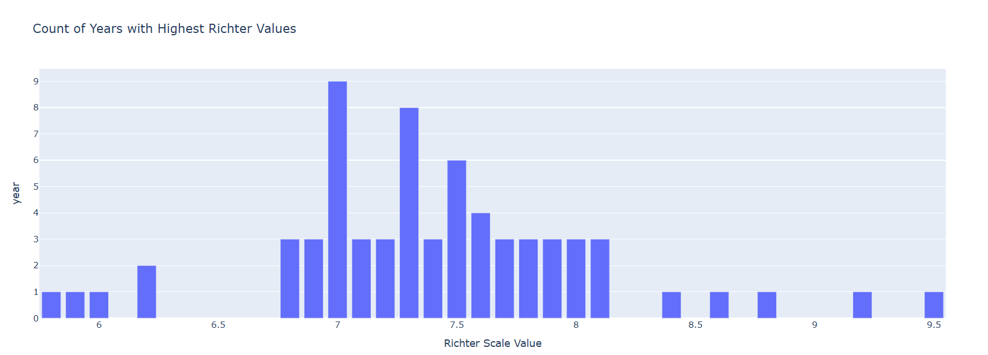
1.Count of Years with Highest Richter Values.
To count the number of years with the highest Richter scale values, data on significant earthquakes over a period of time is required. By analyzing the data, we could identify the years in which the highest-magnitude earthquakes occurred.

Slide 6
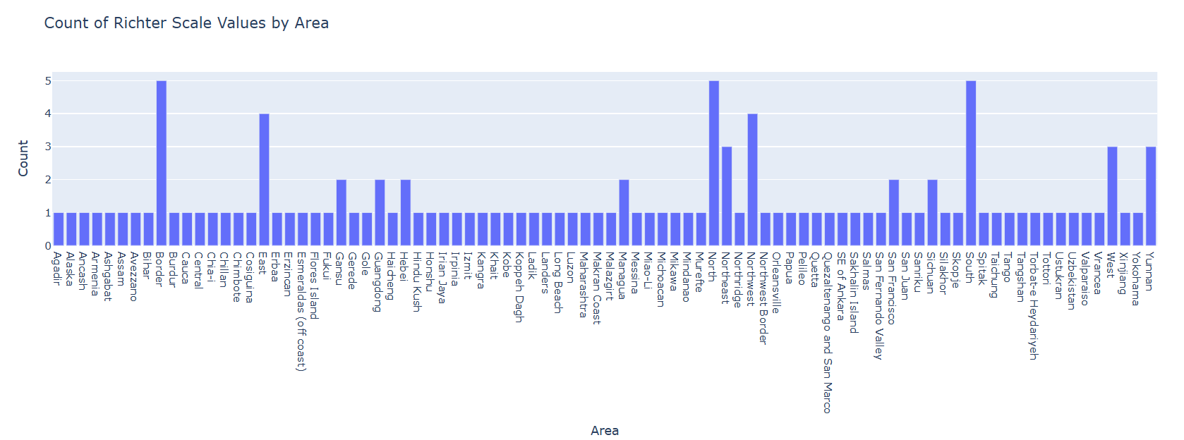
2.Count of Richter Scale Values by Area and Region.
To count Richter scale values by area and region, earthquake data needs to be categorized by geographic location. This allows us to determine how often earthquakes of varying magnitudes occur in specific regions, helping assess seismic risk in those areas.

Slide 7
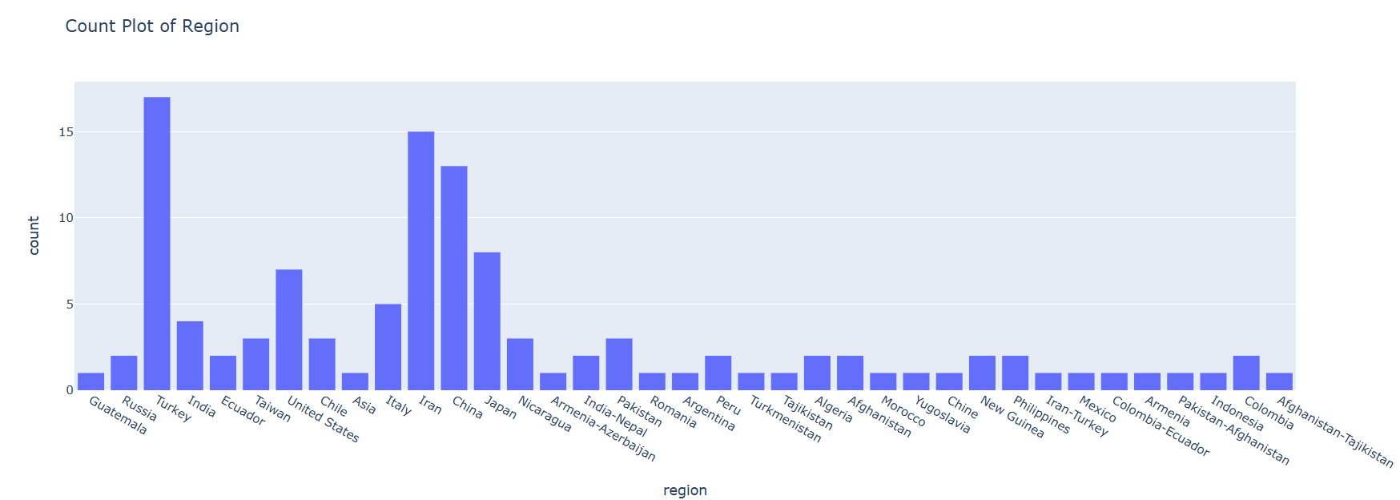
3.Count of Richter Scale Values by Region.
To count Richter scale values by region, earthquake data is sorted based on geographic regions. This allows the calculation of how many earthquakes of different magnitudes occurred in each region, helping to assess seismic activity and risks in those areas.

Slide 8
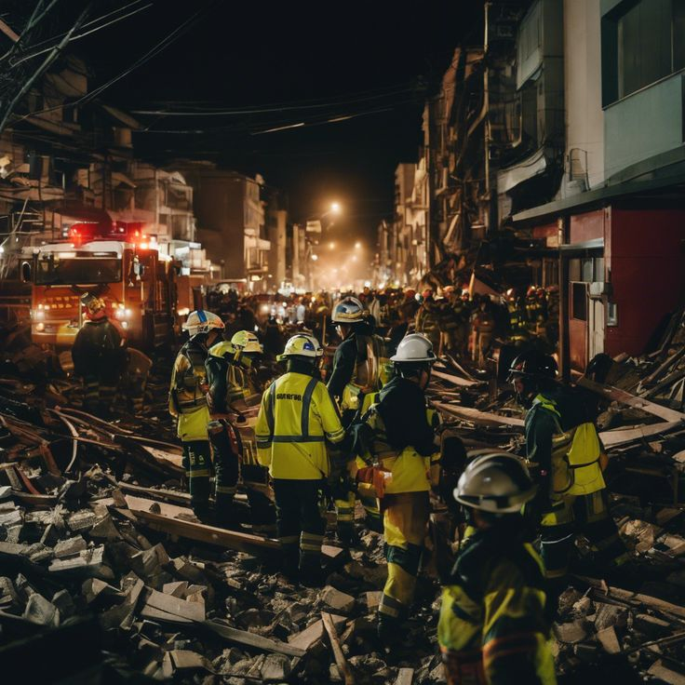
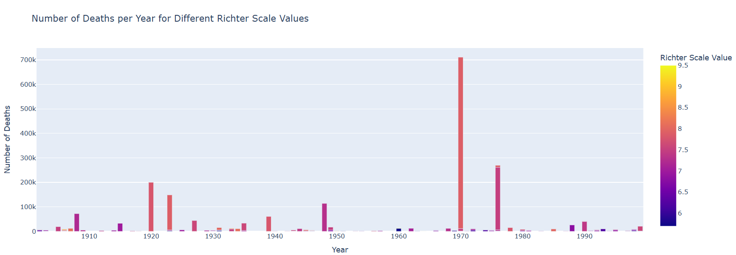
4.Number of Deaths per Year for Different Richter Scale Values.
To analyze the number of deaths per year for different Richter scale values, earthquake data must be correlated with casualty figures. This helps to assess the severity of earthquakes by magnitude and their impact on human life each year.

Slide 9
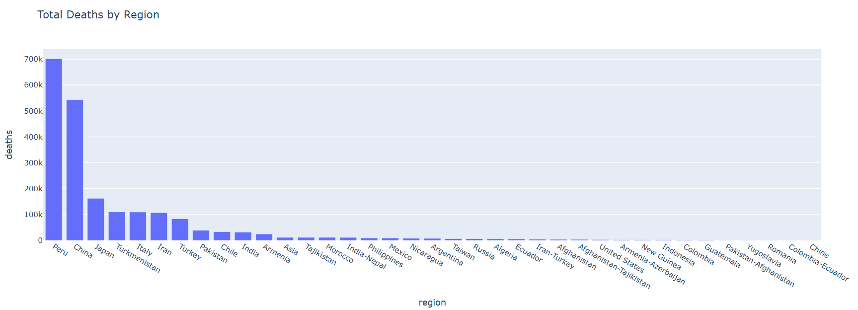
5.Total Deaths by Region.
To calculate total deaths by region, earthquake data must be combined with casualty reports for each specific area. This allows for the estimation of how many fatalities occurred in each region due to earthquakes, highlighting regions most affected by seismic activity.

Slide 10
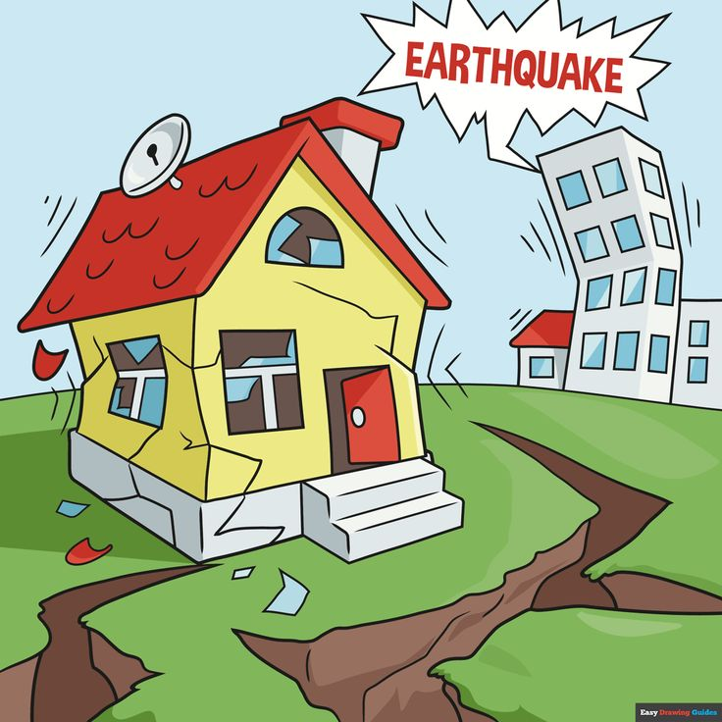
Conclusion:-
In conclusion, earthquakes are powerful natural events caused by the sudden release of energy from the Earth's crust. They result from the movement of tectonic plates and can vary in magnitude, intensity, and impact. While earthquakes can occur anywhere, certain regions, such as the Pacific Ring of Fire, are more prone due to tectonic activity.
The severity of an earthquake is measured on the Richter scale or the moment magnitude scale, with larger earthquakes causing significant destruction to infrastructure, landscapes, and even entire communities. Smaller earthquakes, though less damaging, are frequent and help scientists monitor and understand seismic activity.
Human populations in earthquake-prone areas face a greater risk of injury and death, particularly if buildings and infrastructure are not designed to withstand seismic forces. Preparedness through early warning systems, strict building codes, and public education can significantly reduce the loss of life and property damage.
Research and advancements in earthquake prediction continue to improve, but the unpredictable nature of earthquakes makes it essential for countries and communities to focus on resilience and response strategies. Ultimately, a combination of scientific understanding, proactive measures, and global cooperation can minimize the devastating effects of earthquakes and ensure the safety of vulnerable populations.

Slide 11
Thank You So Much

